Slide 1

SHOPPING CART
Project Supervisor: Ms. USHA NANDINI M.E.,(Ph.D.,)
Student Name :SIGINAMSETTY SAI SUSHVANTH
Reg.No : 38110532

Slide 2
TABLE OF CONTENTS
Introduction
Objective
Technology used
Module Implementation
Software and hardware configuration
Results and Discussions
Conclusion
References

Slide 3
INTRODUCTION
The aim of the project is to built an application in Html,Css & Javascript.
An online shopping store which will allow formal and informal merchants in developing countries to advertise and sell their good on the internet.
Customer user have limited right to access the system while the admin user have full control over the system.

Slide 4
OBJECTIVE
The objective of the project to certain e-commerce, web portal with a content management system which would allow product information to be updated securely using a mobile device.
To make the shopping easier and comfortable.
To serve the customer report without wasting their precious time.

Slide 5
TECHNOLOGIES USED
FRONT END: PHP, HTML
shopping kart web page is developed by using Php & html.
BACKEND : MY SQL
The Database is used to stored user login information.
The database also stores the information of registration details.

Slide 6
Module Implementation
To implement our module first we need to access the any software module which I mentioned below in software configuration .
Next , we need to click on the file which we stored as .html file
Then the page will open in the software module which we given access .

Slide 7
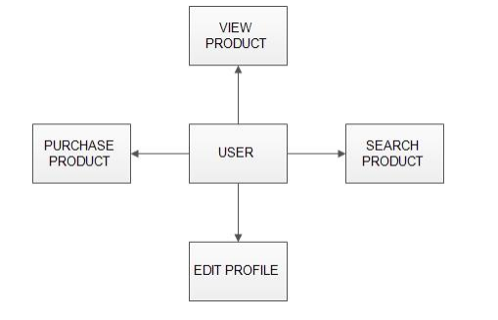
View Point of User :

Slide 8
Registration page view:
User name
Phone number
Password
E mail
Registration
Address

Slide 9
Login page view point:
E-Mail
Password
login
New User

Slide 10
Software configuration
Operating system: Windows 10/8/7
Wamp Server
Web Browser
My Sql

Slide 11
Hardware configuration
Processor: Intel Pentium or more
Ram:4Gb
Hard disk:500Gb

Slide 12

Home page:

Slide 13
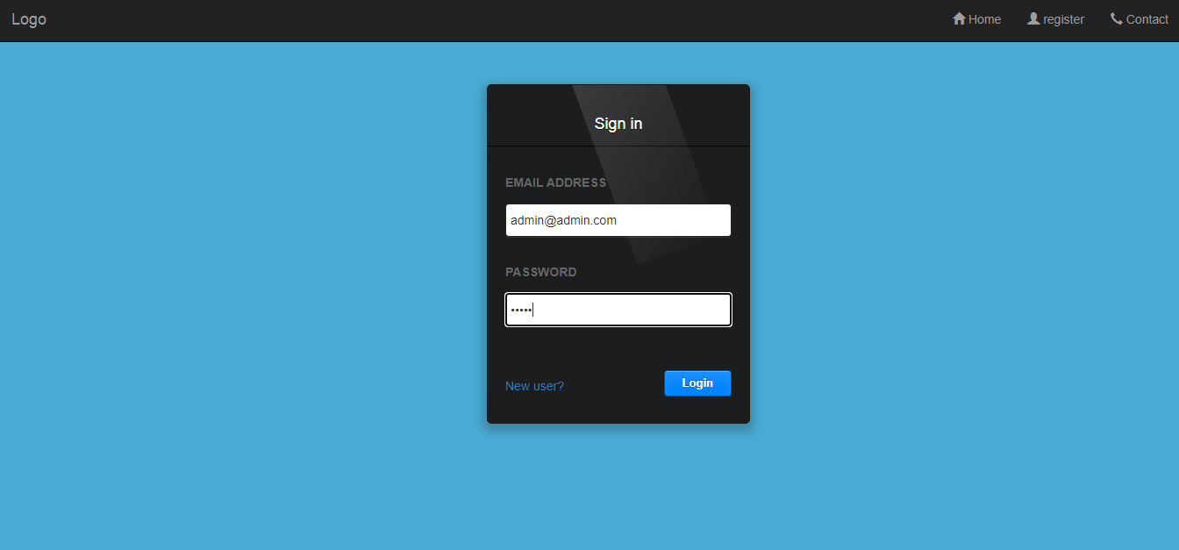
Login page:

Slide 14
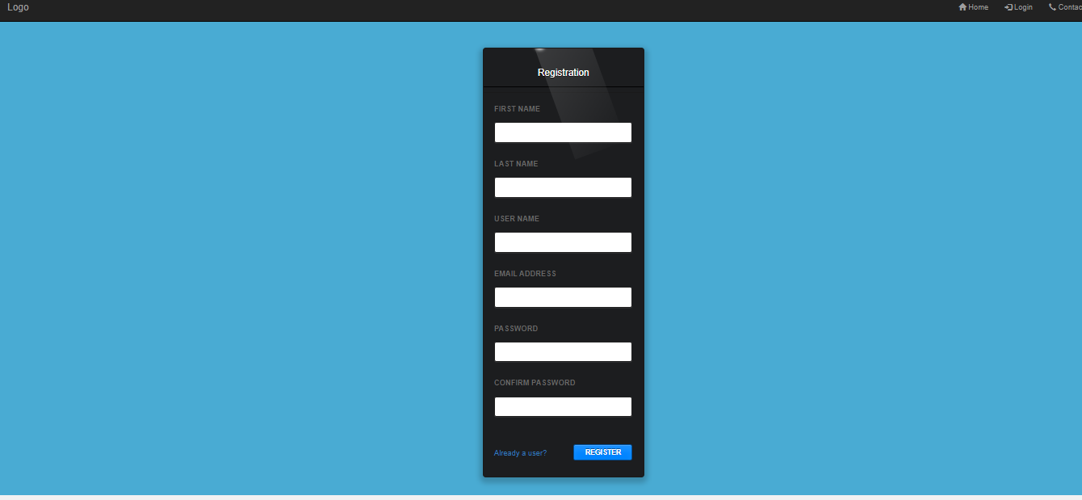
Registration page:

Slide 15
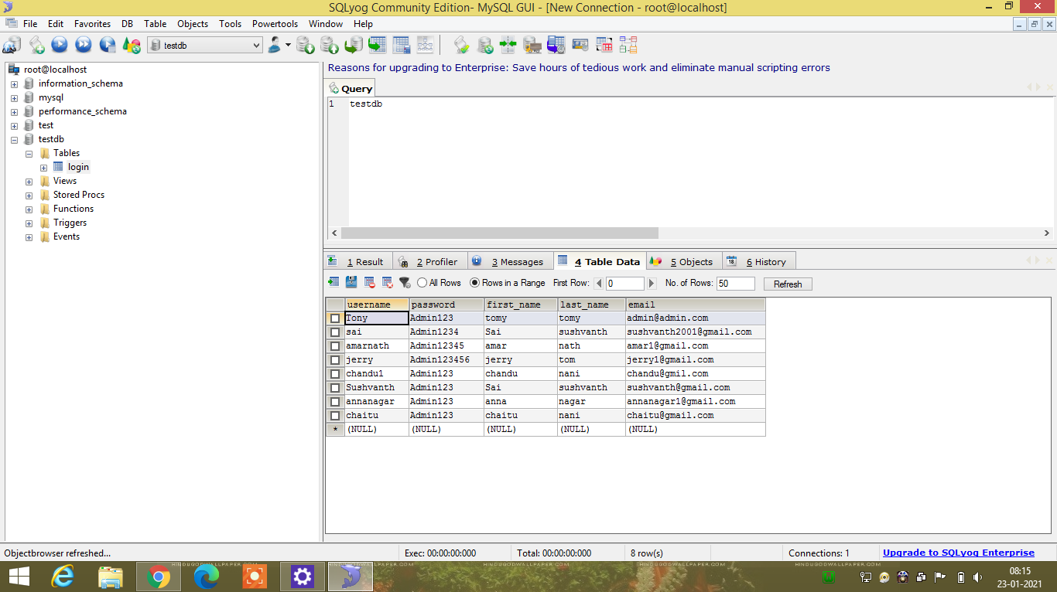
Database

Slide 16
Results and Discussions
The application can be used for any Ecommerce application. It is easy to use, since it uses the GUI provided in the user dialog. User friendly screens are provided. The application is easy to use and interactive making online shopping a recreational activity for users. It has been thoroughly tested and implemented.

Slide 17
CONCLUSION
From the project I conclude that the web page created using html, css, javascript for shoppingcart easier.
This project has really been faithful and informative.
It has made us learn and understand the many trivial concepts of HTML,CSS,JAVASCRIPT.

Slide 18
REFERENCES
[1] https://www.geeksforgeeks.org
[2] https://www.w3schools.com
[3] https://developer.mozilla.org

Slide 19

Certificate

Slide 20
THANK YOU

